Slide 2
Autodesk Navisworks Course for Technical Officer (Structural)
Presented by
David Fung

Slide 3
Introduction to Navisworks File System
 | Autodesk Navisworks Freedom | Autodesk Navisworks Simulate | Autodesk Navisworks Manage
Project viewing | ✓ | ✓ | ✓
Project Review |  | ✓ | ✓
Simulation and Analysis |  | ✓ | ✓
Coordination |  |  | ✓
Remarks | Open NWD only | ✗ Clash Detection

Slide 4
Navisworks file types
NWC (Navisworks Cache File)
- interpreter between Navisworks and other software
NWF (Navisworks File Set)
- contain links to the original native files (as listed on the Selection Tree) together with Autodesk Navisworks-specific data, such as review markups
- no model geometry is saved
NWD (Navisworks Model)
- contain all model geometry with Autodesk Navisworks-specific data, such as review markups

Slide 5



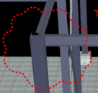


Navisworks file types
NWC (Navisworks Cache File)
NWF (Navisworks File Set)
NWD (Navisworks Model)

Slide 6
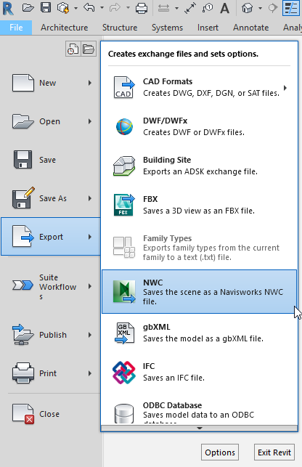


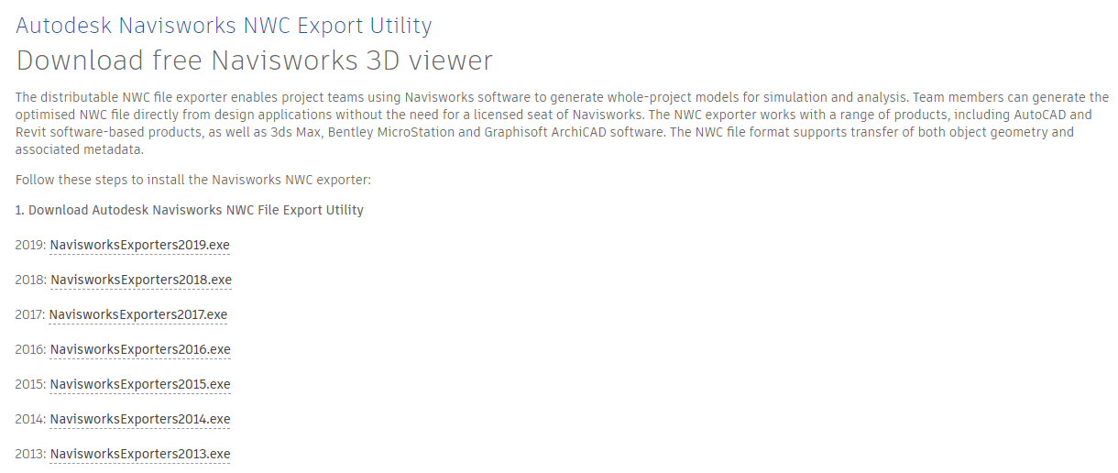
Export from Revit to Navisworks (NWC)
https://www.autodesk.co.uk/products/navisworks/autodesk-navisworks-nwc-export-utility

Slide 7
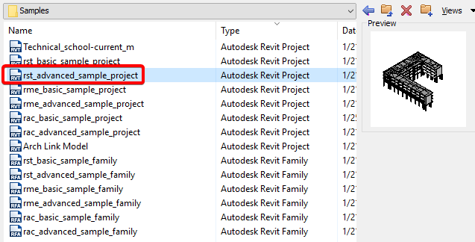
Export from Revit to Navisworks (NWC)
C:\Program Files\Autodesk\Revit 2018\Samples

Slide 8
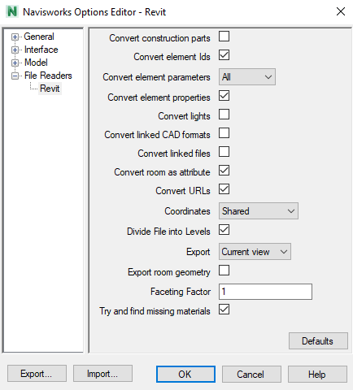

Export from Revit to Navisworks (NWC)

Slide 9
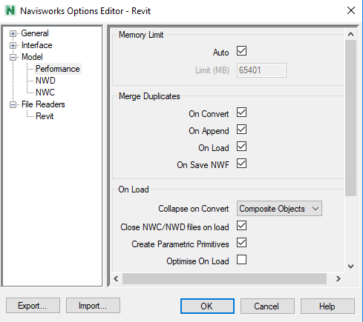
Export from Revit to Navisworks (NWC)

Slide 10
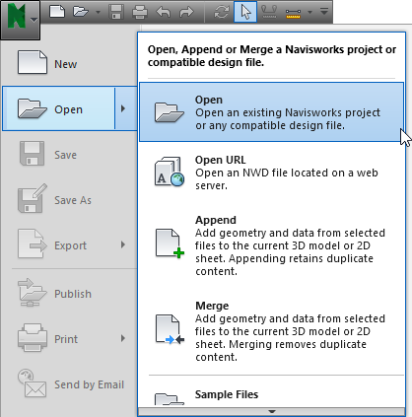
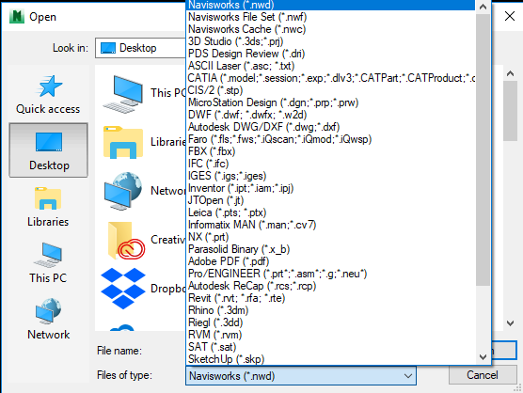
Open File

Slide 11
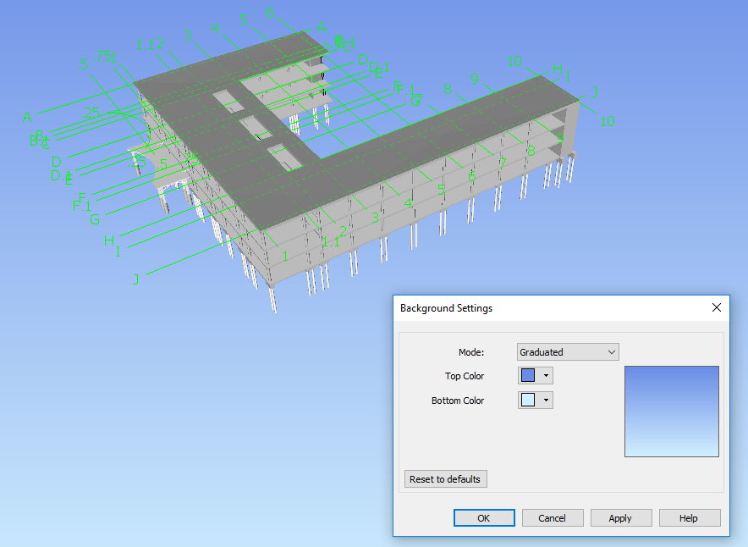
Background Setting

Slide 12
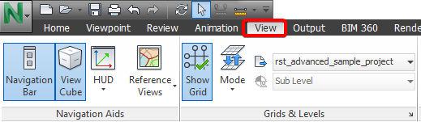
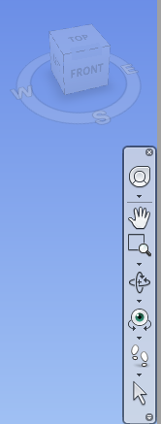
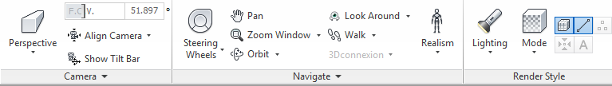
Navigate 3D Model

Slide 13
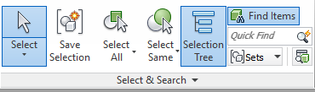
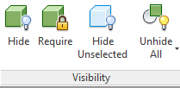

Dealing with Objects

Slide 14
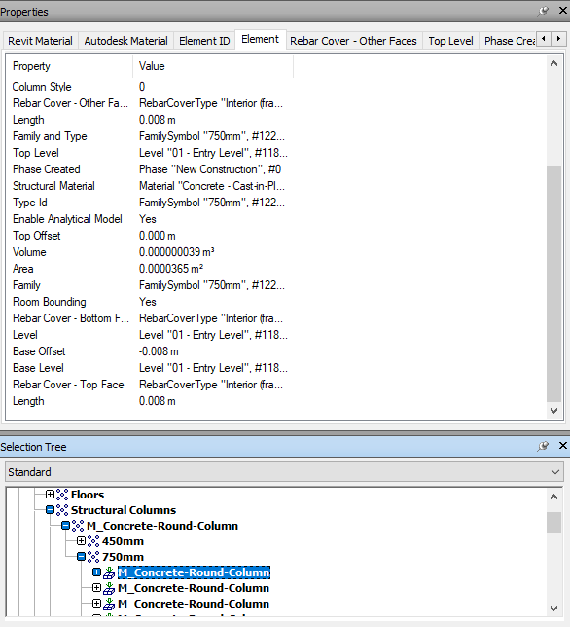
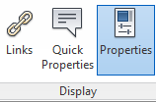
Dealing with Objects

Slide 15
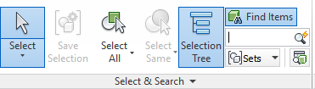
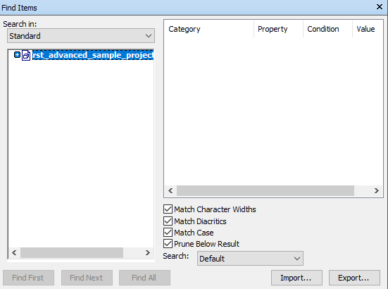
Dealing with Objects

Slide 16
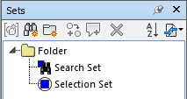
Selection

Slide 17

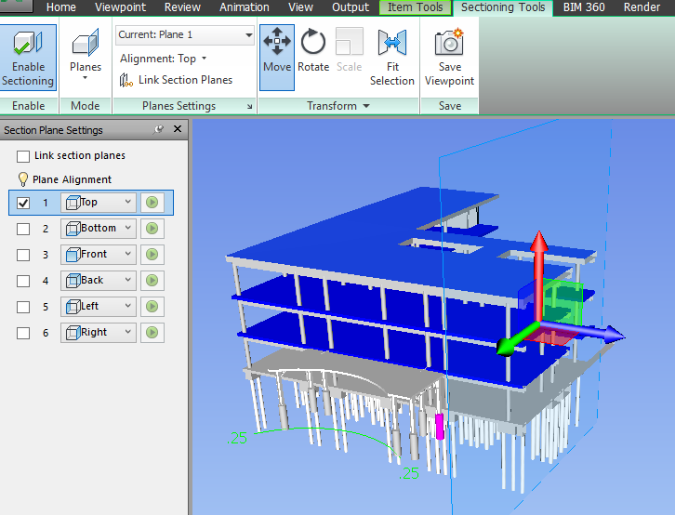
Section View

Slide 18
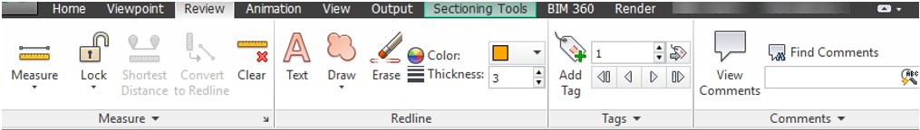
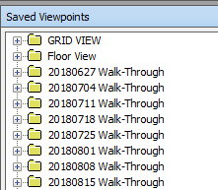
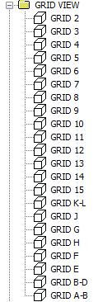
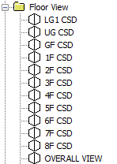
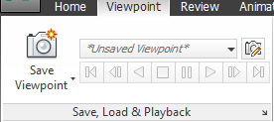

Mark-up

Slide 19
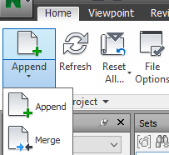
Save NWF

Slide 20
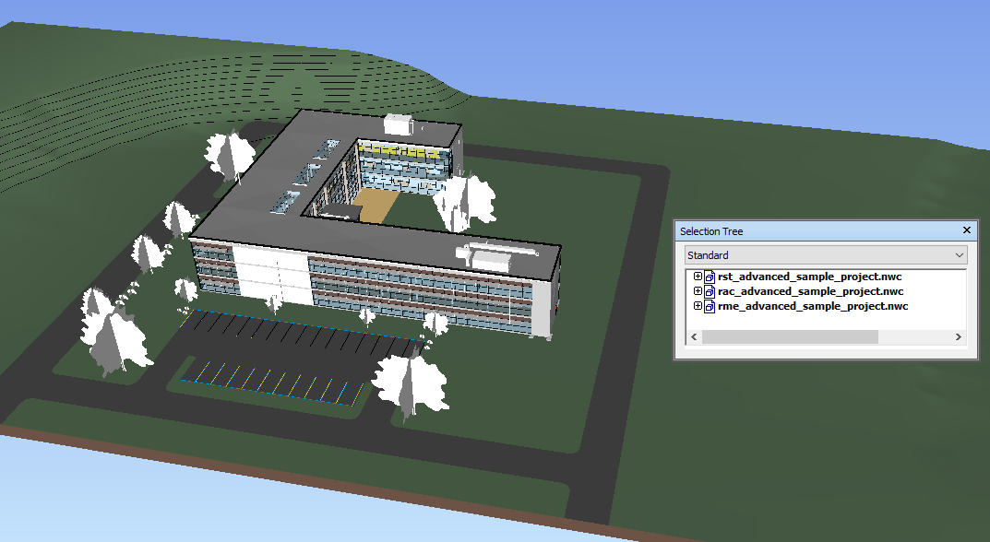
Combine Models

Slide 21
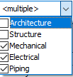
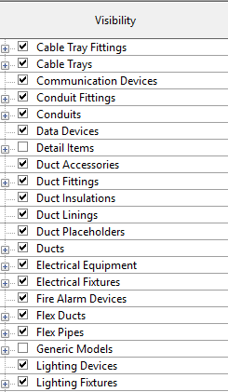
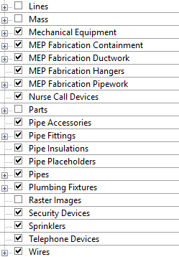
Combine Models

Slide 22
Render Style

Slide 23
Navigate 3D Model

Slide 24
Suggested Setting

Slide 25
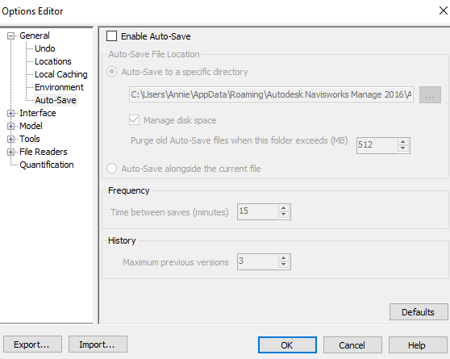
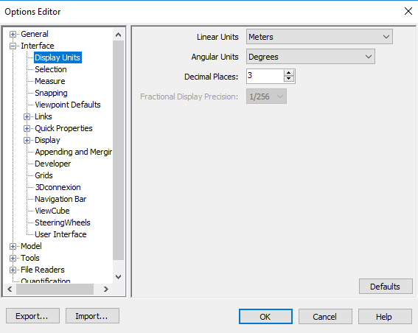
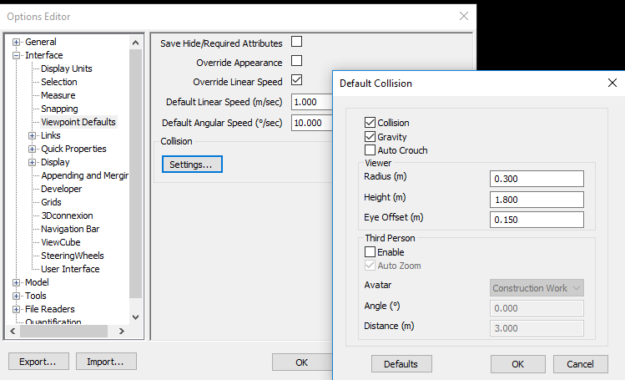
Navisworks Settings

Slide 26
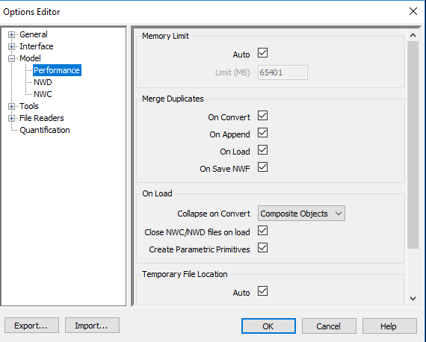
Navisworks Settings

Slide 27
Quantification

Slide 28
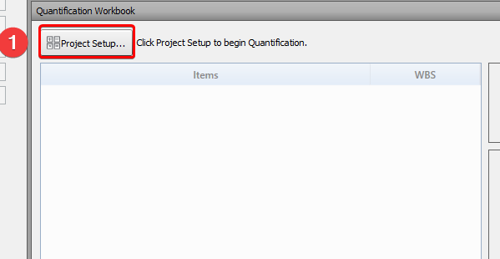
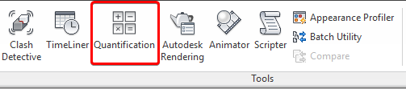
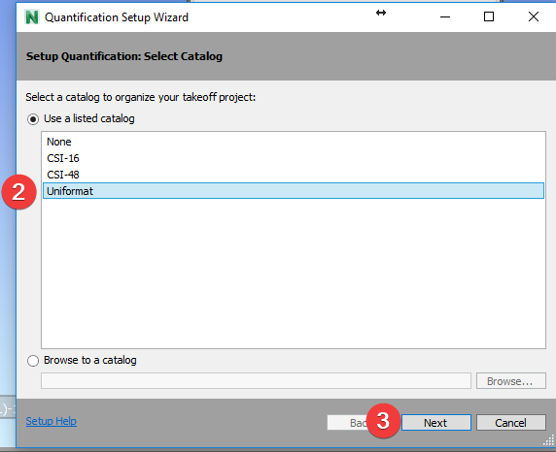
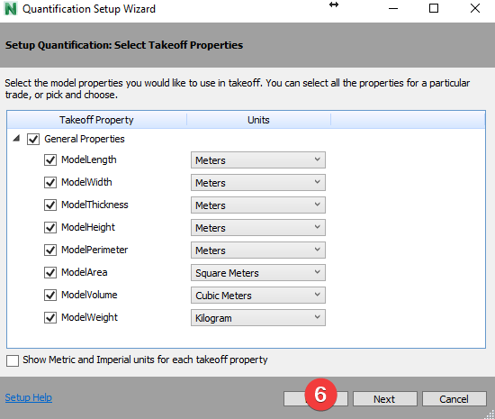
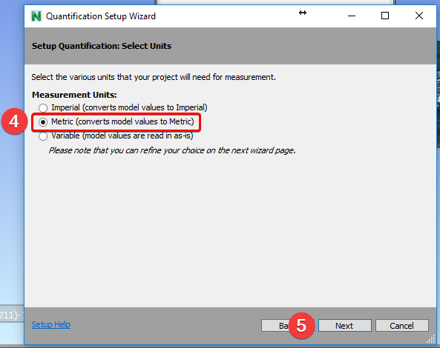
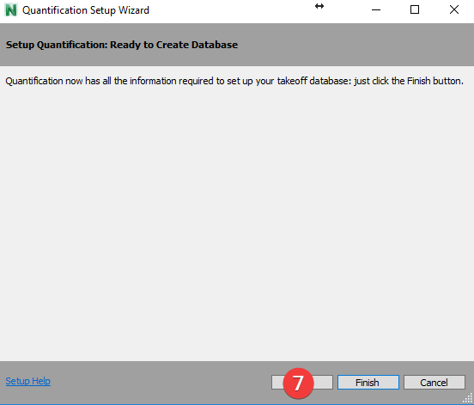
Setting up workbook

Slide 29
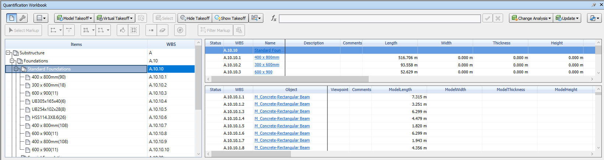
Dragging items to the workbook

Slide 30
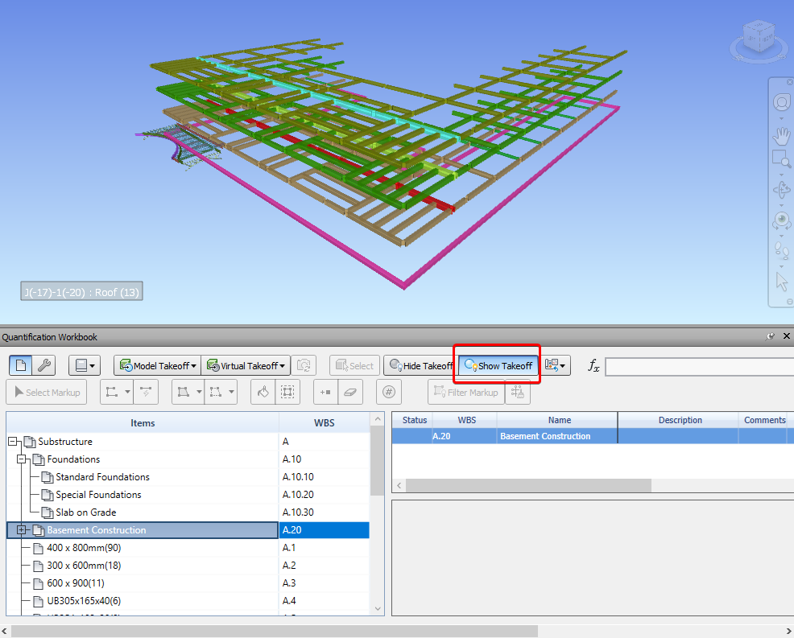
Taking off the entire model

Slide 31
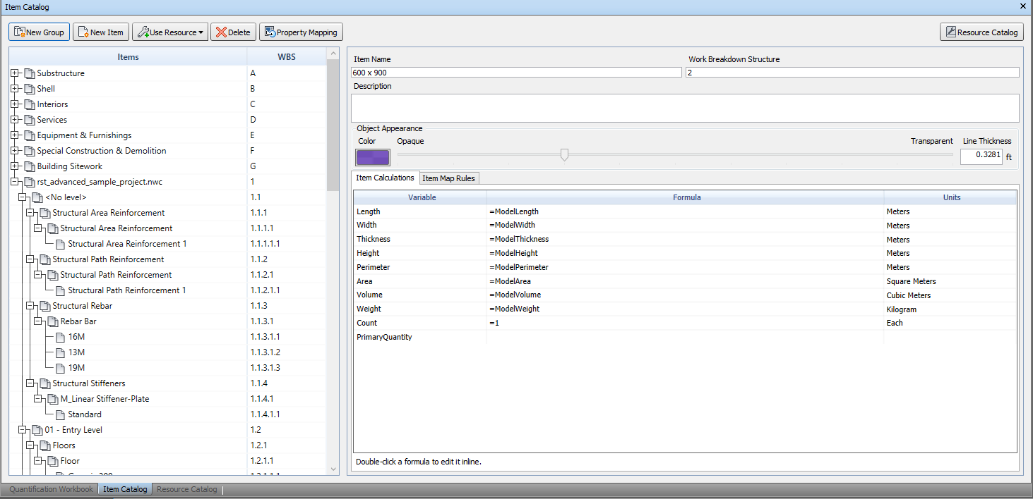
Taking off the entire model

Slide 32
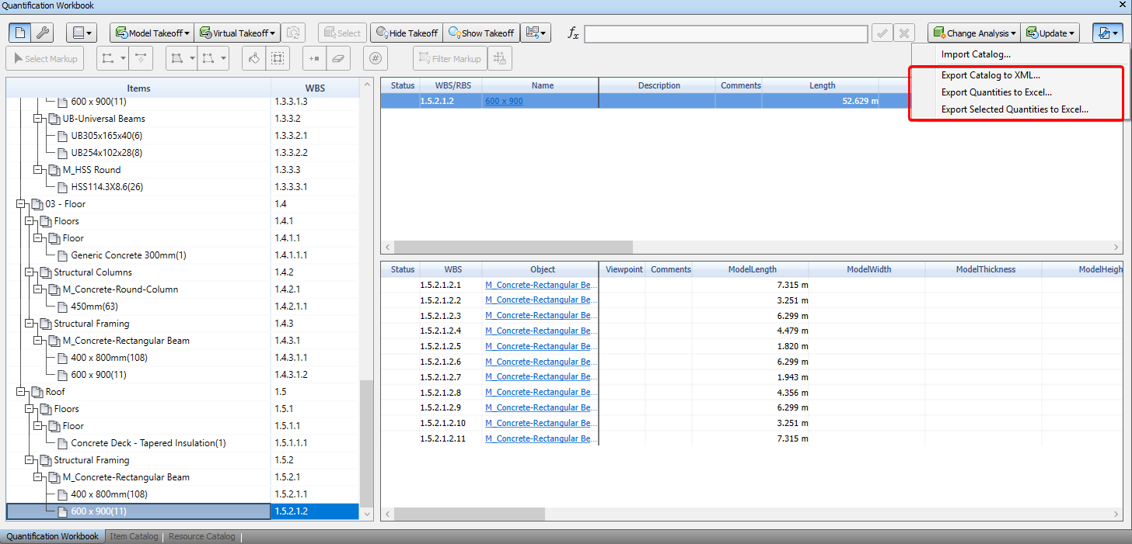
Exporting the takeoff

Slide 33

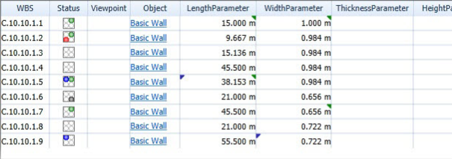
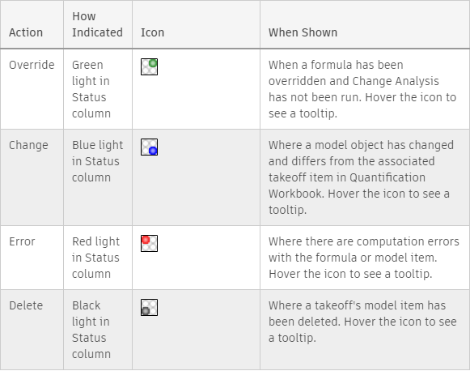
Analysis

Slide 34
Clash Detection

Slide 35

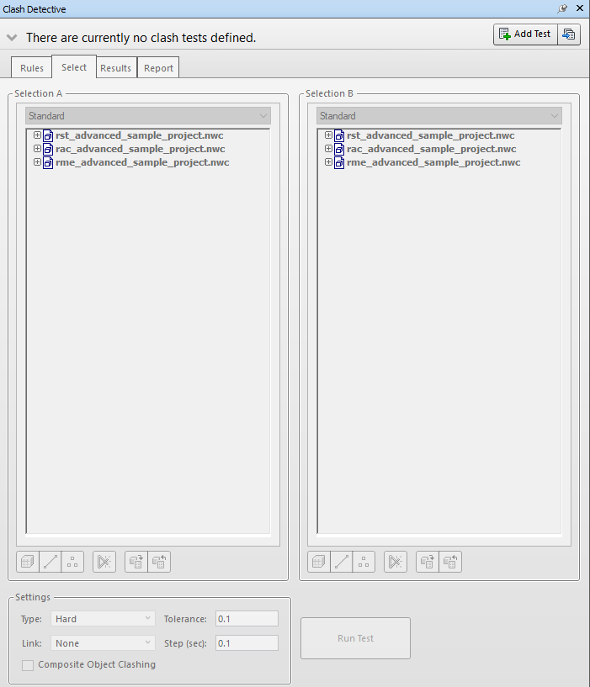
Clash Detection

Slide 36
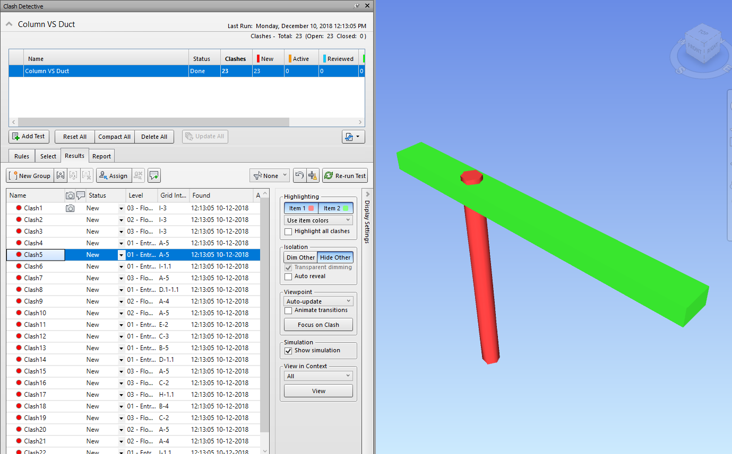
Clash Detection

Slide 37
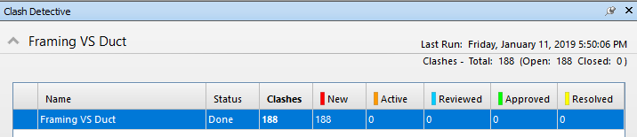
Clash Detection
New - a clash found for the first time in the current run of the test
Active - a clash found in a previous run of the test and not resolved
Reviewed - a clash previously found and marked by somebody as reviewed
Approved - a clash previously found and approved by someone
Resolved - a clash found in a previous run of the test and not found in the current run of the test or marked by somebody as resolved

Slide 38
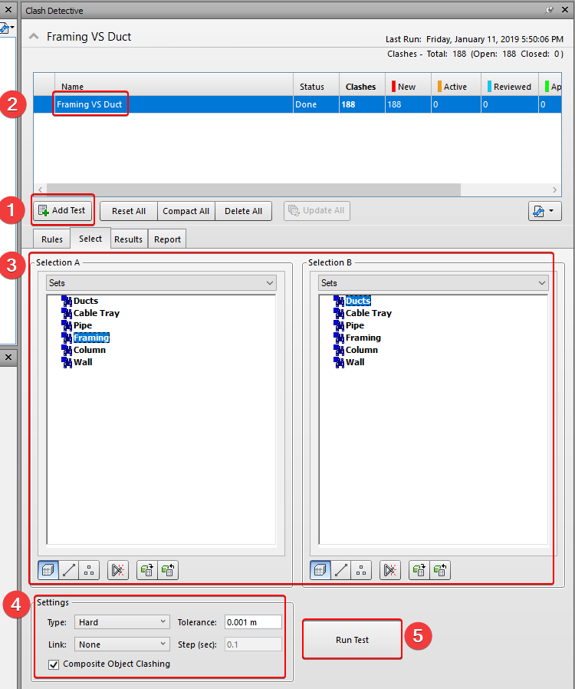
Clash Detection
Hard:
Detecting actual intersections between geometry
Hard (Conservative) Performing with a conservative intersection method
Clearance Checking for geometry within a specific distance (tolerance) from other geometry
Duplicates Detecting for duplicate geometry

Slide 39

Clash Detection
Add Test: Adding a new test
Reset All: Resetting all tests. In other words, this will make the clash test status New
Compact All Removing all “Resolved” clash results from the tests to create smaller files
Delete All: Deleting all tests
Run All: Running all tests

Slide 40


Clash Detection

Slide 41

Clash Detection
Surface
Line
Points
Self intersect
Current Selection to Clash Selection
Select in Scene (Shown in Selection Tree)

Slide 42



Clash Detection
Comment
Status
Assigned To

Slide 43

Clash Detection

Slide 44


Clash Detection

Slide 45
Animation_1

Slide 46



Animation_1

Slide 47
4D Construction Sequence

Slide 48







4D Construction Sequence
3D Model (New Construction/ Existing Building…)
Construction Program/ Master Program
Construction Zoning Plan
Site Layout Plan
Construction Equipment/ vehicle

Slide 49


Work with TimeLiner

Slide 50


Work with TimeLiner

Slide 51



Work with Master Program/ Construction Schedule

Slide 52


Work with TimeLiner

Slide 53



Work with TimeLiner

Slide 54

Work with TimeLiner

Slide 55


Work with TimeLiner
Planned and Actual show according to the dates.
Planned (Actual Differences) shows things at their planned dates but with color info about real late start or early finish.
Planned against Actual uses the actual dates but includes info if something starts or finishes out of time.
Actual (Planned Differences) shows things at their actual dates but with color info about planned early start or late finish.

Slide 56

Work with TimeLiner Animation

Slide 57

Export 4D Construction Sequence (AVI)

Slide 58
4D Construction Sequence_Exercise

Slide 59

TimeLiner_Exercise
Prepare 3D model (NWC)
Prepare Master program by excel (XML => CSV)

Slide 60



TimeLiner_Exercise

Slide 61


TimeLiner_Exercise

Slide 62



TimeLiner_Exercise
Selection Set
Search Set (Find item)
Comments/ User parameters in original source (Revit)
Selection Tree
Quick Properties
Hide/ Unhide
Selection Box
Turn off “Line” rending

Slide 63

TimeLiner_Exercise

Slide 64

TimeLiner_Exercise

Slide 65

TimeLiner_Exercise

Slide 66

TimeLiner_Exercise

Slide 67

Animation

Slide 68



Export 4D Construction Sequence (AVI)
FPS from 8-30
Anti-aliasing between (8x-64x)

Slide 69
NWD Model Editing_Exercise

Slide 70


NWD Model Editing_Exercise
Different formats of models received
Open model in Navisworks

Slide 71

NWD Model Editing_Exercise
Different formats of models received
Open model in Navisworks (Convert to NWD Format)

Slide 72




NWD Model Editing_Exercise
Check SCALE!!!

Slide 73
NWD Model Editing_Exercise
Check SCALE!!!

Slide 74




NWD Model Editing_Exercise

Slide 75


NWD Model Editing_Exercise
3D Model in Navisworks
Construction Equipment/ vehicle in Navisworks
Combine models in Navisworks
Check Location!!!

Slide 76



NWD Model Editing_Exercise
3D Model in Navisworks
Construction Equipment/ vehicle in Navisworks
Combine models in Navisworks
Check Location!!!

Slide 77


NWD Model Editing_Exercise

Slide 78
Animation_2

Slide 79






Animation_2

Slide 80

Animation_2
Capture Object Movement
Capture Object Rotation
Capture Scaling Changes
Capture Color Changes
Capture Transparency Changes

Slide 81



Animation_2

Slide 82

Attach with TimeLiner

Slide 83

Animation_3

Slide 84



Animation_3

Slide 85
Animation_3

Slide 86
Practical

Slide 87


Exercise

Slide 88



Appearance Profiler

Slide 89

Appearance Profiler

Slide 90

Get Element Location (View Cube)

Slide 91



Find Elements in Revit

Slide 92



Switching back to Revit

Slide 93

Grouping Clash (Manually)

Slide 94

.----------------------------------
Clipping Planes
To have a better setting on clipping plane:
low number for “Near”
large number for “Far”

Slide 95

.----------------------------------
Viewpoint Setting
Assign special setting for viewpoint

Slide 96
Presentation Skill

Slide 97


Edit Element Object

Slide 98


Printing
PDF
maximum image size is 2048 x 2048 pixels

Slide 99



Export Viewpoints Report

Slide 100
Thank you

